Slide 1
Learning Tools Interoperability in Sakai-25
Dr. Charles Severance, University of Michigan
Sakai PMC Chair
Learning Experiences

Slide 2
AGENDA
Ancient Pre-LTI History
Ancient LTI history
LTI 1.3 History
Post LTI 1.3 History
LTI and Sakai 25
The Future of Standards and Sakai
Summary

Slide 3
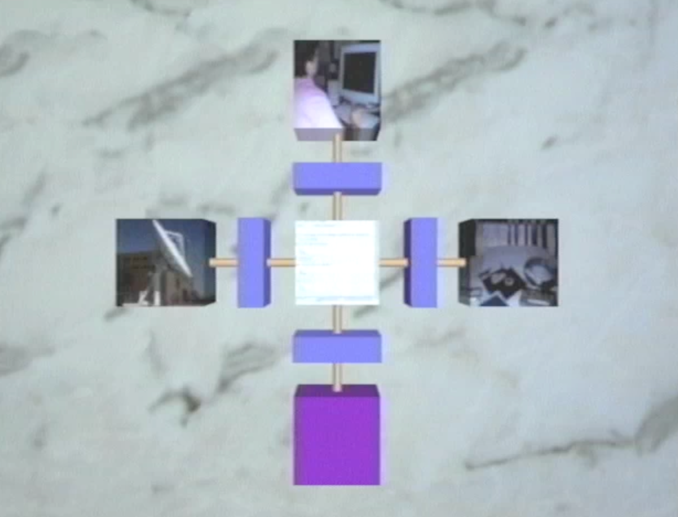
Sakai History - Pre IMS
1990 – IEEE POSIX 1003.0 - Guide to the POSIX Open System Environment (OSE)
2003 Sakai Mellon Grant - Tool Portability Profile
https://www.youtube.com/watch?v=31bS6cUHj-U

Slide 4
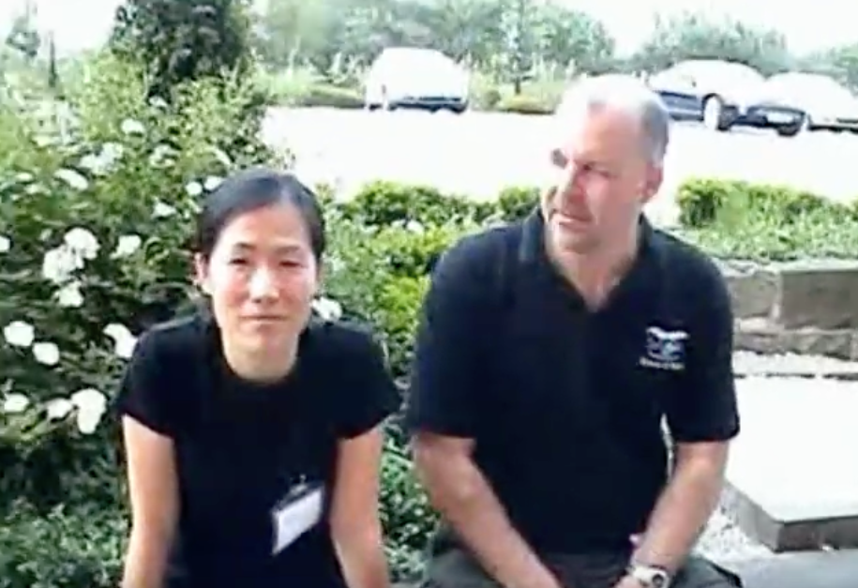
Early Sakai / IMS History
August 2004 - *the* meeting – WebCT / Blackboard / Sakai
IMS Tools Interoperability (TI)
June 2005 – Demo Sheffield, UK
Nov 2006 – TI 1.0 released
https://www.youtube.com/watch?v=SFH2Ltic9nc

Slide 5


Dr. Chuck Sakai Dark Times 1.0…
I resigned as Sakai's Executive Director early in 2007 due to a difference with my board
I became a faculty member at UM School of Information and focused on IMS
https://www.dr-chuck.com/sakai-book/

Slide 6
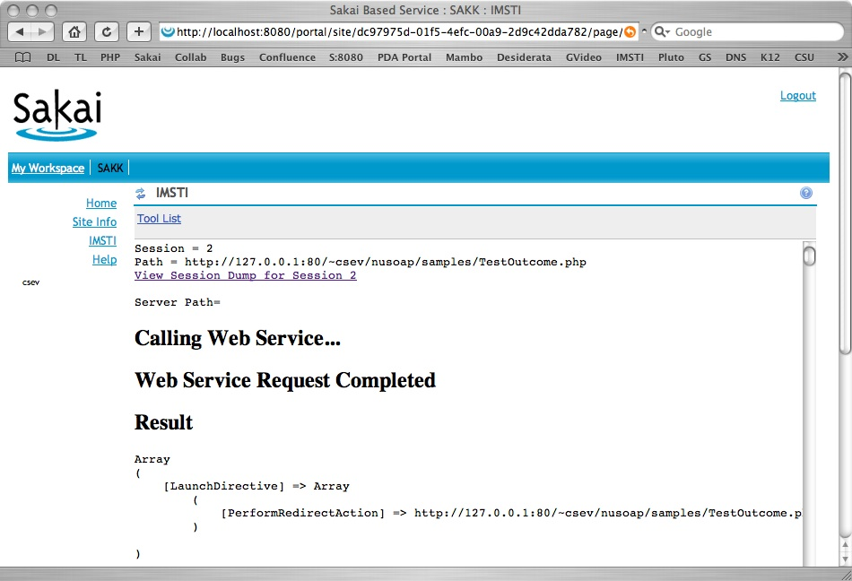
We don't like TI 1.0 – Lets build LTI 1.0!
Too Complex Start over!
2007 Horizon Wimba had an idea
Quickly got complex
2008 Pearson had an idea (TPI)
Quickly got complex

Slide 7
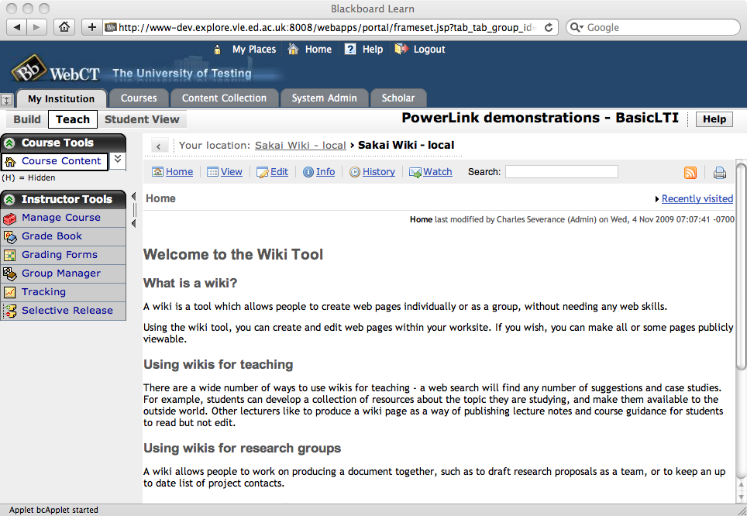
Sakai-led experiments
2008 SimpleLTI – Subset of Pearson
2009 Evolved into BasicLTI
2010 Published as LTI 1.0
No grade passback

Slide 8
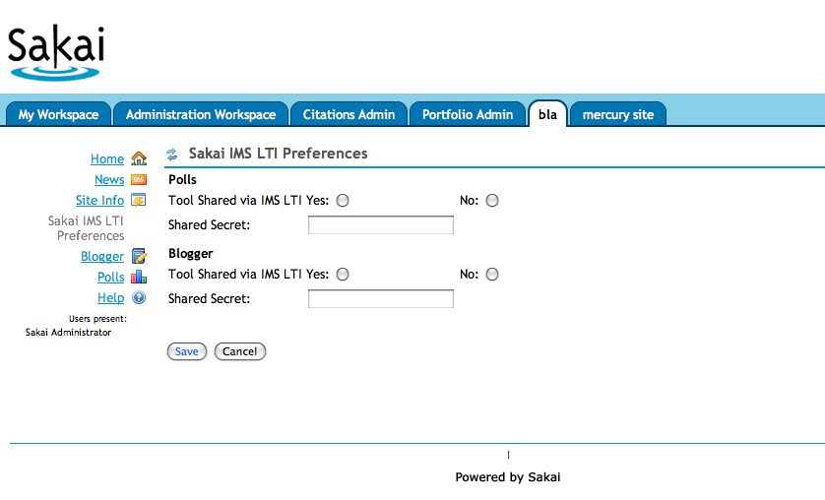
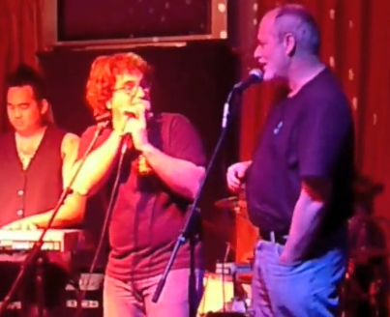
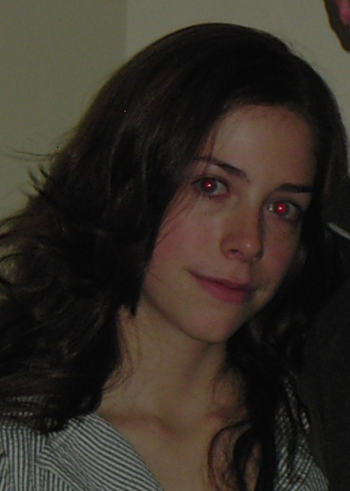
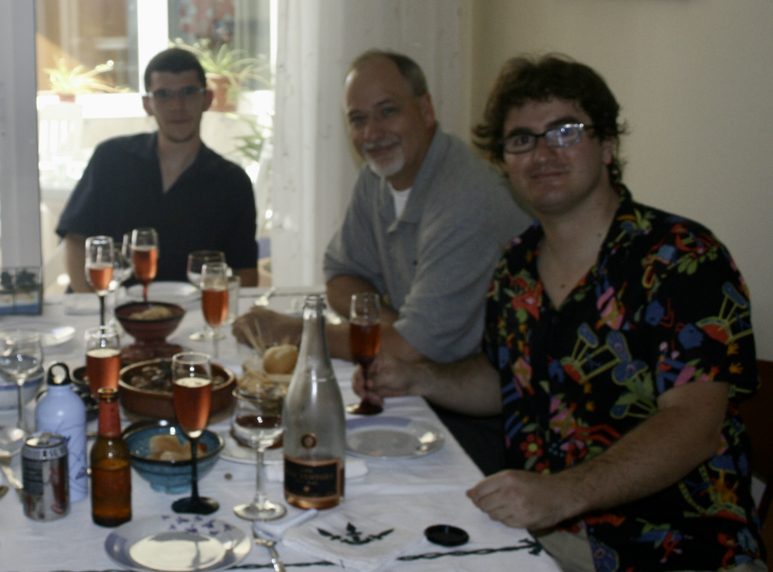

Sakai 2008 – Google Summer of Code
I wrote up "SimpleLTI" –"Pearson subset"
Kati Luchini – McGill - Wrote prototype Sakai LTI Provider
Jordi Piguillem Poch / Marc Alier - Barcelona wrote initial LTI module in Moodle

Slide 9
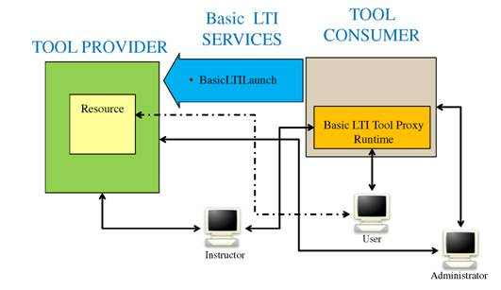
LTI 1.0 – 17-May 2010
Simple LTI was re-branded "BasicLTI" to hint at future expansion and published
It was launch only – no grade pass back
I was a consultant for IMS promoting Sakai

Slide 10
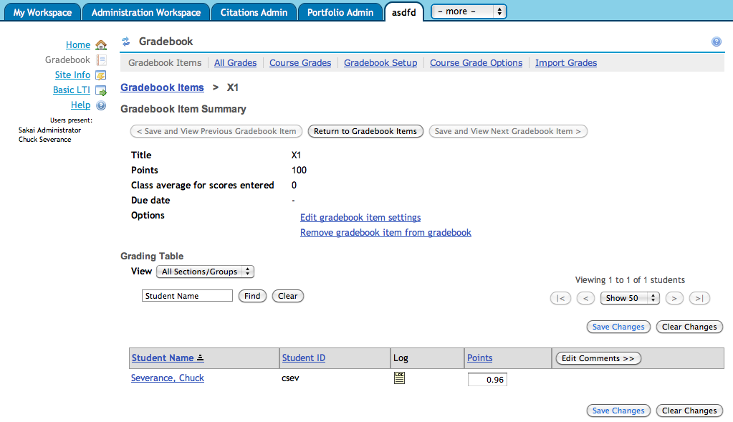
LTI 1.1 – Returning Grades
Even as LTI 1.0 was being published, the LTI 1.1 draft was in progress
XML based "Basic Outcomes"
LTI 1.1 in Sakai July, 2010
Spec released 12-March-2012

Slide 11
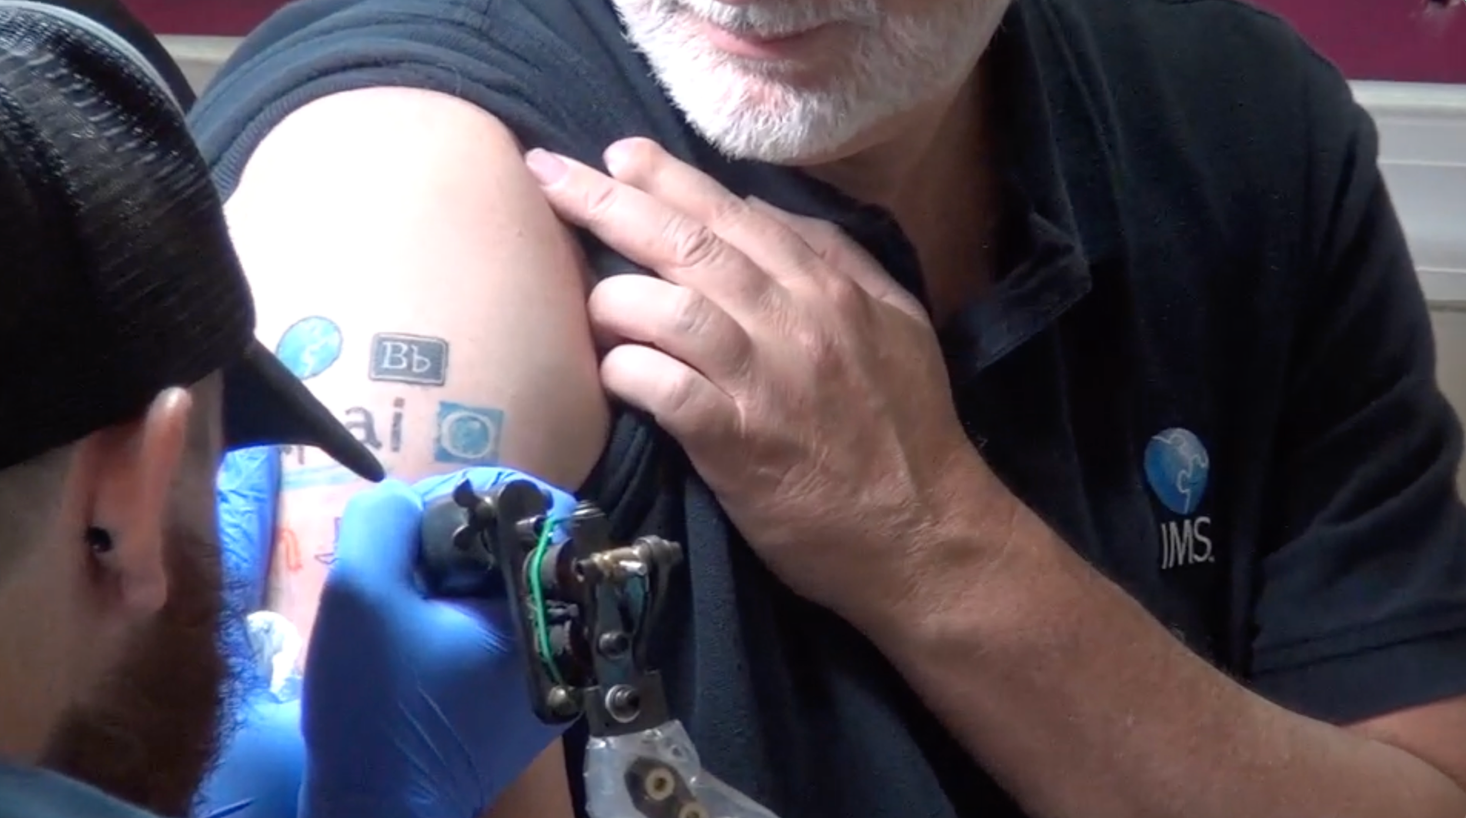
Chuck as Part Time IMS Consultant
Certification suite for LTI 1.0 and 1.1
Open source reference implementation
Promoted spec compliance through the "IMS LTI Ring of Compliance"
https://www.youtube.com/watch?v=VY-Ogkc7Mnw

Slide 12
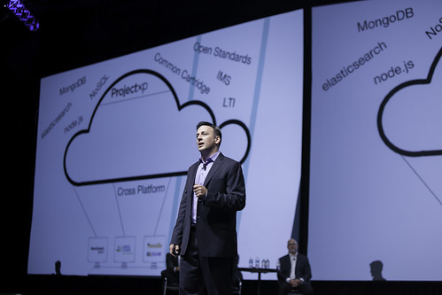
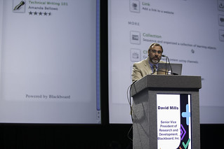
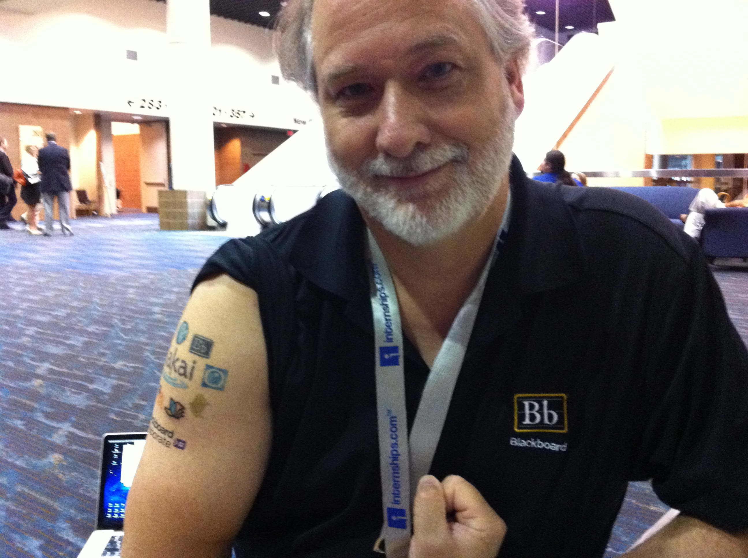

LTI 2.0 / Chuck Working for Blackboard
2012 Blackboard bought Angel Learning and MoodleRooms
Multi-LMS LOR – xpLor
Blackboard supported work on Sakai, and xpLor, and LTI 2.0 2012-2014

Slide 13
LTI 2.0 #FailToAdopt
Pearson was the lead – excessively elegant
Sakai, Blackboard, Moodle, and Canvas implemented it
Little enthusiasm from the tools
Removed from Sakai in SAK-40065 (2018)

Slide 14

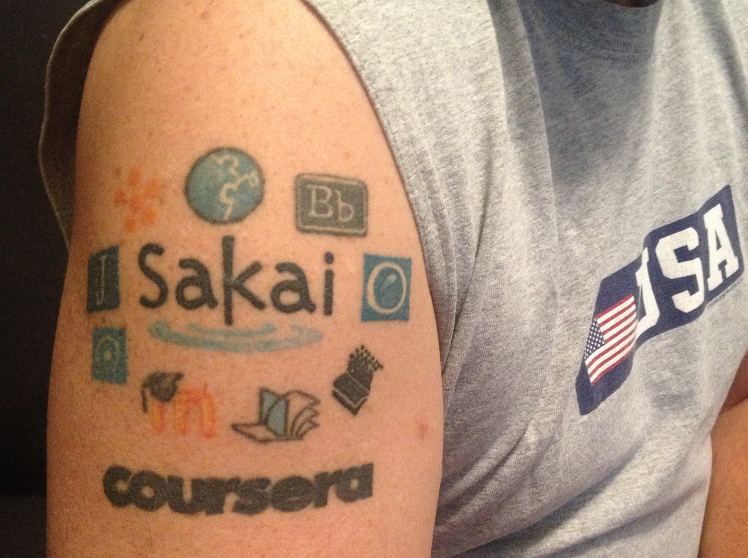
The Dr. Chuck Dark Ages 2.0…
After LTI 2.0 failed, I was sad
Coursera / edX founded in 2013
Founding schools left Sakai for Canvas in 2015
From 2013-2015 I barely attended IMS meetings – PKI blah blah

Slide 15
LTI 1.3: We Need a Better LTI 1.1
By 2015, Canvas had extensive LTI 1.1 extensions
It was an existential moment for the LMS Market
Gave focus to the LTI 1.3 work

Slide 16
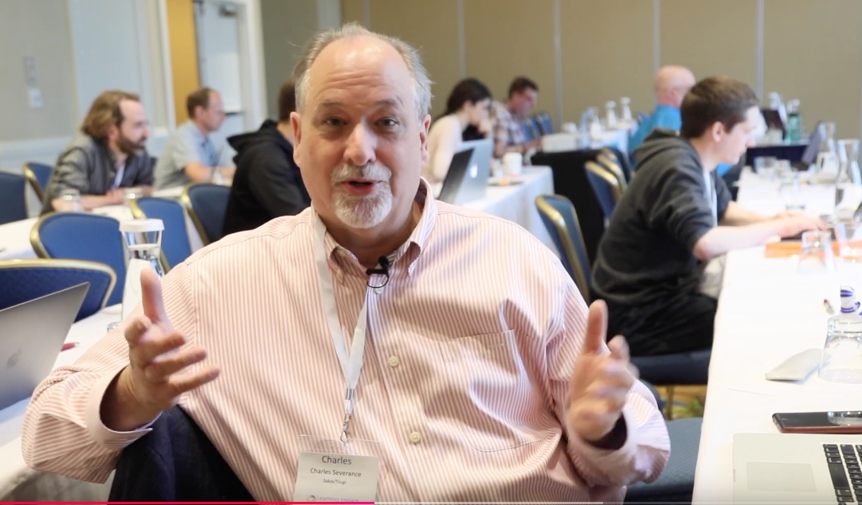
LTI 1.3 Reaches Critical Mass…
23-May-2018 I attended a hackathon and went from curmudgeon to fan
Martin Lennard (TurnitIn) wrote a free PHP reference implementation
Claude Vervoort [Cengauge] had a Moodle prototype
https://www.youtube.com/watch?v=akDUM1SXMxE

Slide 17
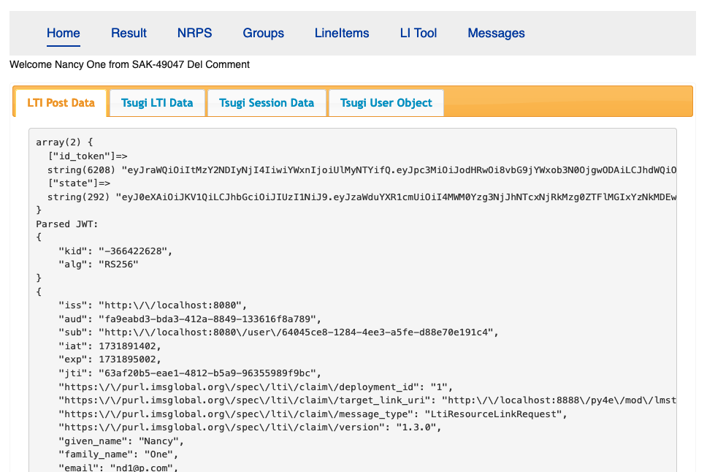
Sakai / Tsugi - Leading LTI 1.3 Forward
LTI Advantage – 16-April-2019
LTI 1.3 Launch
Deep Linking
Names and Roles
Assignments and Grades
Blackboard, Sakai-19, Canvas, D2L, and Tsugi Certified Immediately
Dynamic Registration – 13-Oct-2020

Slide 18

https://spongebob.gavinr.com/

Slide 19
Sakai-23 LTI
LTI 1.3 Is A great solution
Sakai 23 had been evolving since 2005 with many new standards, many draft standards that never were released, and some standards that were released but not adopted.
The administration UI was massive and hard to understand
It was missing needed instructor features and inconsistent.
The UI depended on when a feature was developed and there was no refactor..

Slide 20
Sakai-25 LTI
Remove cruft from the admin UI
Make the instructor UI simpler and consistent
Rename 'basiclti' to 'lti' in the code
Add Groups Service
Introduce "Deploy to Sites"
The most requested feature for 10 years ☺
Thanks to Zhuo Yang

Slide 21
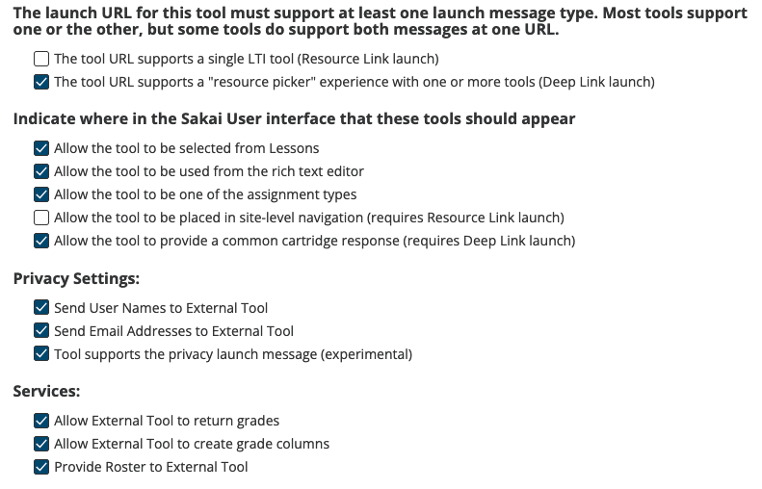

Slide 22
Post Sakai-25 Standards Roadmap
Keep up with new LTI standards as they are developed and released
Starting to explore standards far superior content interoperability
Common Cartridge 2.0 ??
Question Test Interoperability (QTI) 3.0
Accessibility
Flexibility
Simplicity

Slide 23
SUMMARY
Sakai caused the LTI effort to be started in 2004
Sakai standards for almost a =decade before "standards became cool"
For 20 years, Sakai was usually the first to implement – often before a standard was released
Sakai and later Tsugi gave the market reference implementations and interoperability test plans
We placed market adoption over our own own competitive position – it was always for the greater good.
By Sakai-23 there was a lot of code and UI Cruft
Sakai-25 cleaned up code and UI
Tool Interoperability is mature, sustainable, with many organizations contributing
It is time for Sakai to positively impact standards for content and assessment interoperability

Slide 24
THANK YOU
SPEAKER NAME
CONTACT INFO
WEBSITE

